Slide 1
Geometric Growth & Decay

Slide 3
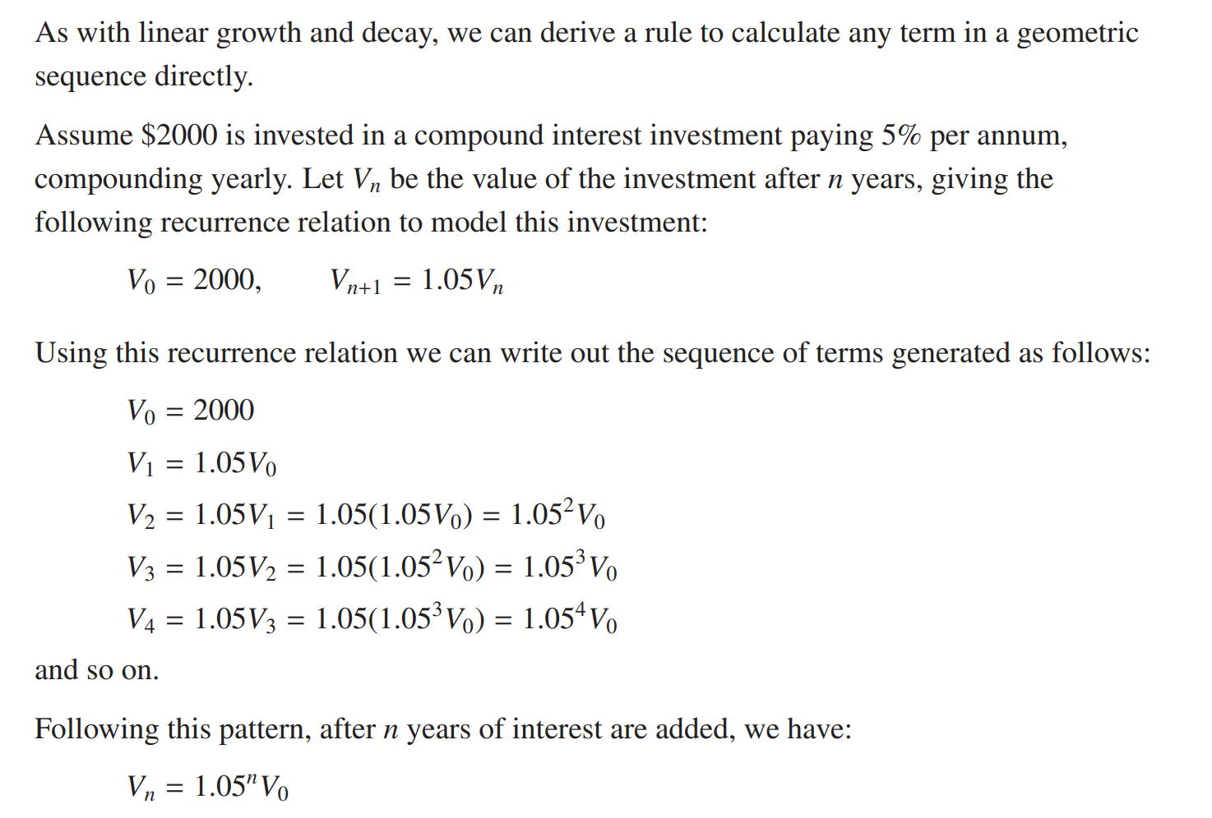

Slide 4
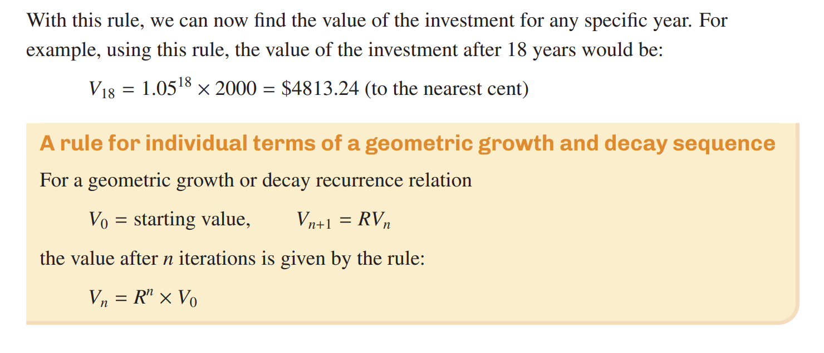
Exactly the same rule will work for both growth and decay, noting that R > 1 is used for
growth and R < 1 for decay.

Slide 5
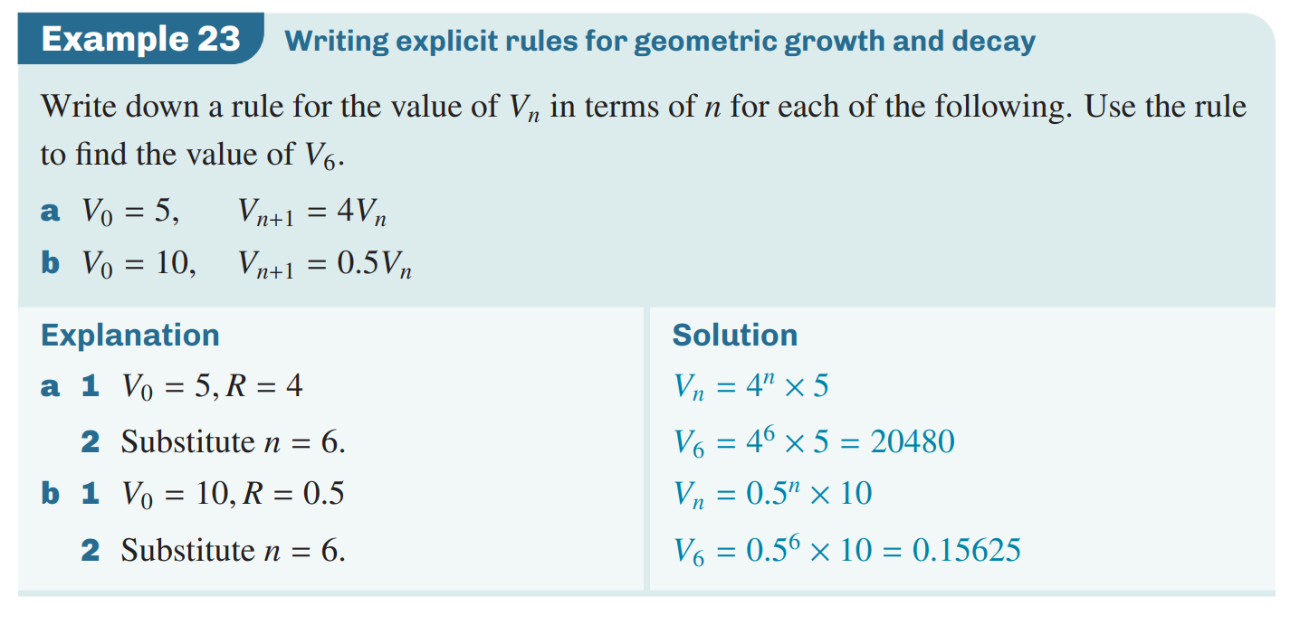

Slide 7
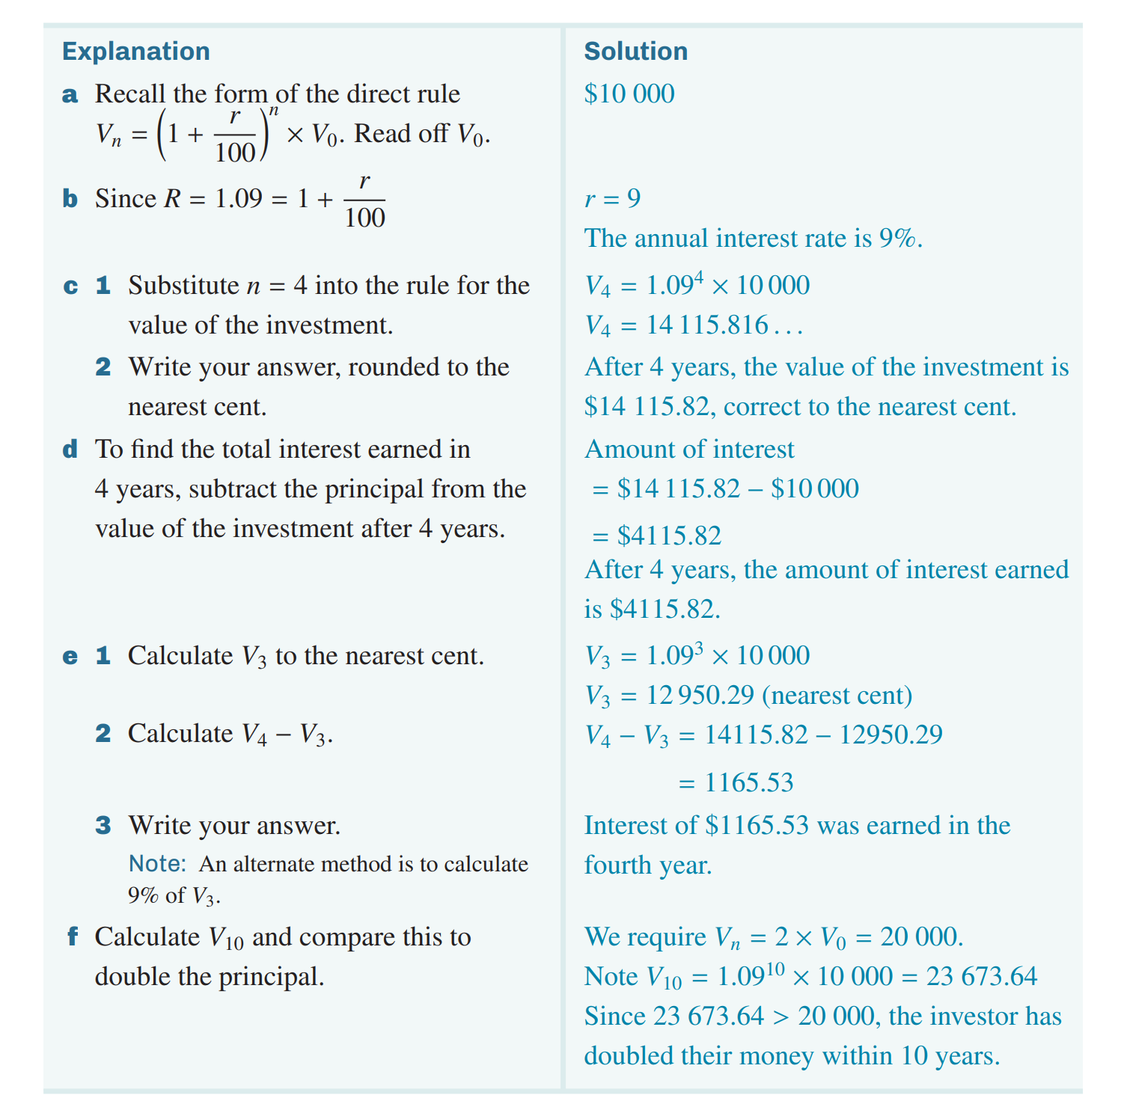
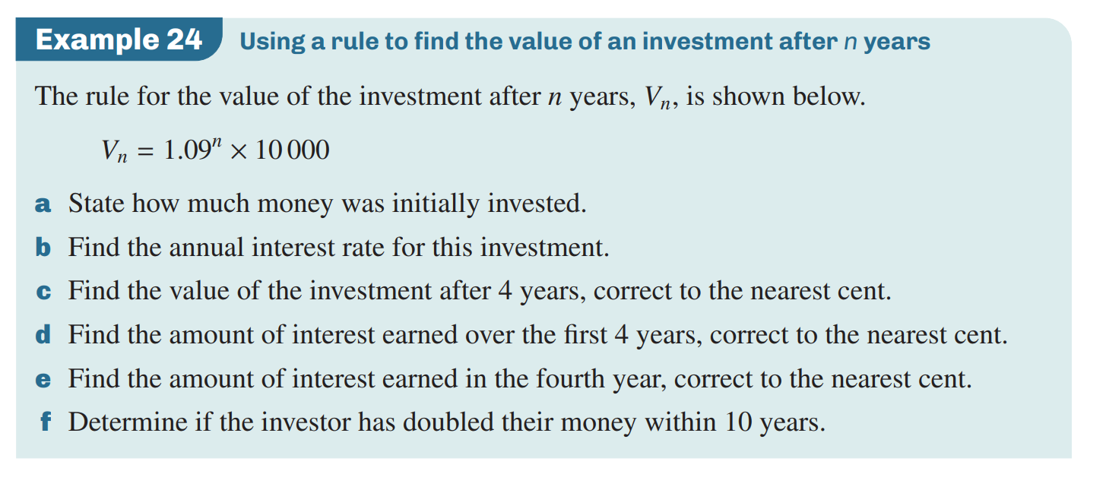

Slide 8
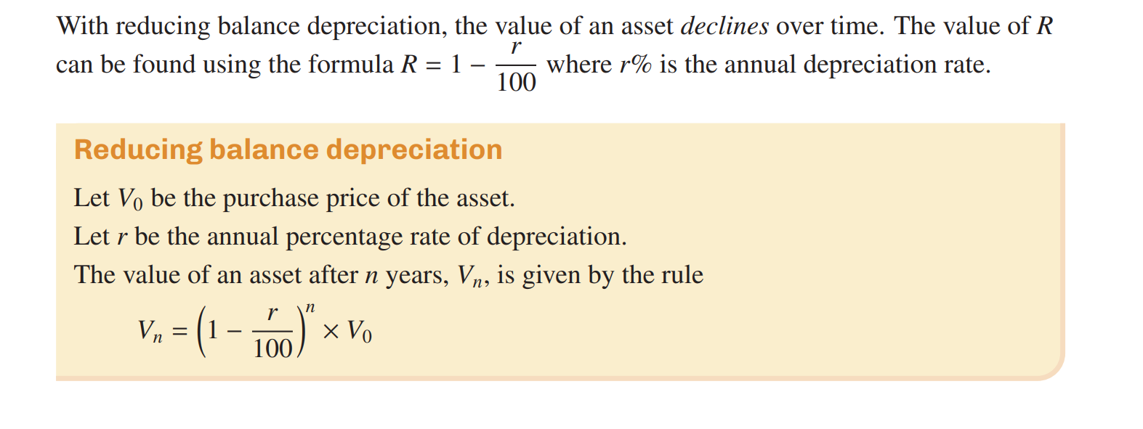

Slide 9
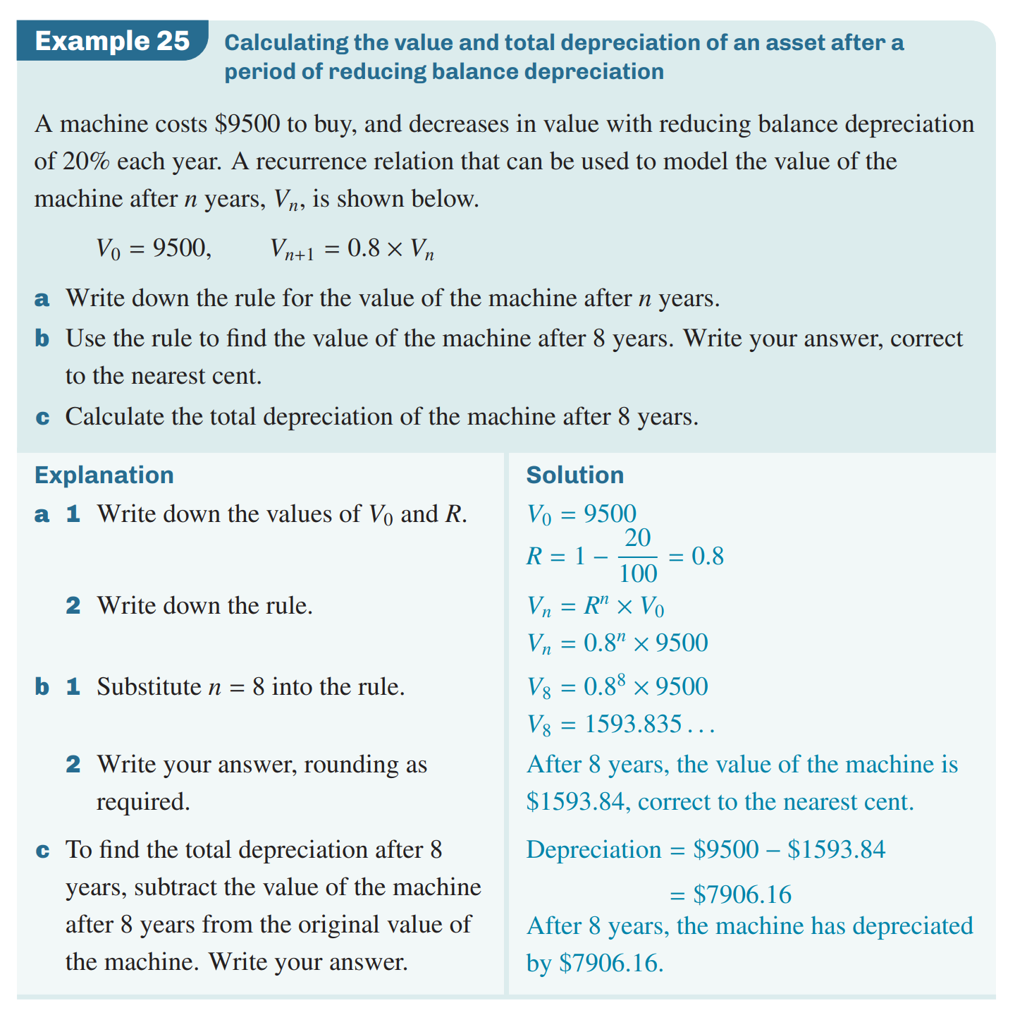

Slide 11
Complete Exercise 7E Q1,3,4, 7,12, 13,14

